Slide 1
Starter
Please get your homework out ☺
In the back of your books – how many words can you make out of the letters in:
e.g. mean, hung, tame…
Challenge: Who can make the longest word?!
Katniss Everdeen
The Hunger Games

Slide 2
Motifs and Symbols
Learning objective:
To explore a key symbol of The Hunger Games.
To understand the use of flashback, and evaluate its effect.

Slide 3
Flowers
What flowers/flowers names have we come across so far in the book?
Primrose
Buttercup
Read again!
Page 56, “The idea pulls me up short…”
To page 59, “I kept us alive.”

Slide 4
Dandelions
What do dandelions symbolise in the book?
Katniss saved her family by learning what plants were safe to eat
Katniss learned that dandelions could be used for food
That hope is not lost
“…when I saw the dandelion and knew hope wasn’t lost.”
After Peeta gave Katniss the bread that saved her from starvation, she saw a field of dandelions.
Notes:
Add to a flower motif/symbol page in books

Slide 5
Flashbacks
Answer in your exercise book:
What is the purpose of this flashback?
What new information does it give us about Katniss?
How might this information be relevant for what is to come?
Do we find out any more information about her relationships with the other characters in the book?

Slide 6
Embedded Clause
“He hasn’t accepted his death. He is already fighting hard to stay alive. Which also means that kind Peeta Mellark, the boy who gave me the bread, is fighting hard to kill me.”
Where is the embedded clause?
What is its purpose in this quote?
Think
Pair
Share
Notes:
Paired discussion

Slide 7
Homework
Use the internet to research the meaning behind the name Katniss.
Be ready to feedback in Friday’s lesson (19th).

Slide 8



Thinking about fame
GROUP TASK:
In your groups, each create a table within your books entitled, “The Consequences of Fame”.
Create three headings: Positive, Neutral and Negative. List different aspects of fame underneath each heading.
POSITIVE | NEUTRAL | NEGATIVE
Having lots of attention | Having lots more friends | Everybody knowing your business
Notes:
Prep for reading Chapter 5

Slide 9

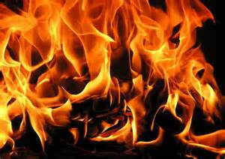
Task: Let’s read chapter 5.
Notes:
9

Slide 10
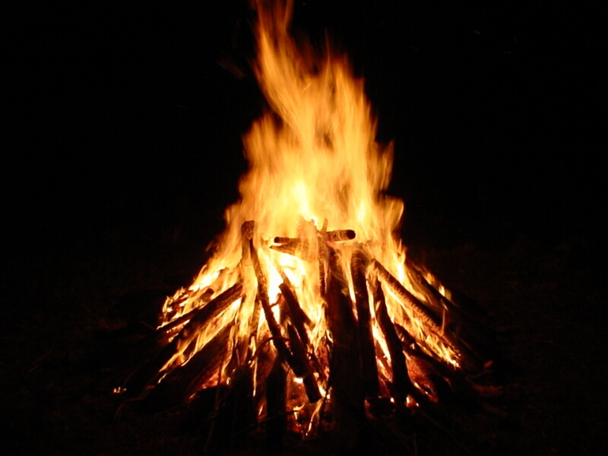
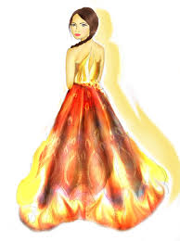
Fire
What does fire symbolise?
What does the fact that Katniss is on fire suggest?

